Slide 1

ISSUE TRACKING SYSTEM
Developed by:
Patel Alpa(Roll no:10)
Shah Priyanka(Roll no:181))

Slide 2
Introduction To project
An issue tracking system (ITS) is a web application that allows an enterprise to record and follow the progress of every problem or ”issue” that a computer system user identifies until the problem is resolved. With an ITS,an “issue”, which can be anything from a simple customer question to a detailed technical report of an error or bug, can be tracked by priority status, owner, or some other customized criteria.
An ITS generally provides the user with a way to report an issue, track progression towards its resolution, and know who is responsible for resolving the issue. It also allows the manager of the system to customize the tracking procedure so that unnecessary documentation on the part of the problem solvers does not become a waste of time. Many kinds of enterprises use ITS applications, including software developers, manufacturers, IT help desks, and other service providers.

Slide 3
Project Profile:
Project Title:- | Issue Tracking System.
Project Definition:- | The Issue Tracking system allows you to log and track issues(Error). Users visiting your site can log issues, as can the people involved in the development of your project.
Category | Web Application
Developed For:- | Dsyn Hub pvt.ltd.
External Project Guide:- | MR.Brijesh Kaneriya
Team Size:- | 2
Team Member Name:- | 1)Priyanka Shah(181) 2)Alpa Patel(10)

Slide 4
Objective
No issue will be unfixed in the developed application.
Not only tracking the bugs but also providing the detailed issue information.
As soon as the issues are identified. They are reported to the project manager and developer.
To ensure that who needs to know about the issue can learn soon after it is reported.
Information about issues will be detailed and organized in order to schedule issue fixes.

Slide 5
TECHNOLOGY, HARDWARE & SOFTWARE SPECIFICATIONS: H
Front End: J2EE(Jsp/Servlet)
Back End: Oracle10g
Tools:
Eclipse jee juno win32
Jdk 1.7
Dream Weaver
Apache Tomcat Server 7.0

Slide 6
Hardware-Software Used
Minimum 1 GB Ram (server)
80 GB Hard Disk
High Speed Internet Connection

Slide 7
Existing System
The organization in which all the works are done manually the management approved the need of computerization of system.
STUDY OF CURRENT SYSTEM
Existing system is based on manual work and all the process are done manually, so they maintain registers and files for recording all the details of the Issue.
Every User’s information was stored in Excel sheet.
No source for viewing project progress for client.
Submitting day to day report to seniors by mailing manually.
There is no security.
We can’t know how many Employee work on issue as well as Total client.
We can’t assign Employee Role Properly.
We can’t categories project such as which issue belong to which Module or Project.
Documents were submitted using mails.
Existing system is manual. So it increases the chances of errors.
Search for any information is done manually, so it is time consuming and tedious.
It is Manual so we can’t know Project’s or issue’s Status.

Slide 8
Need For New System
We have work of developed system. The system has been developed to be very user friendly be introducing help feature guiding the user about what to do next at each step.
The new system will save the time of the Employee and increase efficiency of the Employee.
Such computerized system that human side of the work very systematically, provided information in a very small period of time and help very much in decision.
Requirements of New System
Provide the solved issue at right time.
Provide report day to day to client.
Reduced person dependency.
Effective reporting and presentation of required data.
Security.
Assign Role to Proper Employee.
Easy verification/validation process.
Easy and Fast Searching of User and Project, Module, task, Issue.
Know Status of an issue.

Slide 9
User Type
Admin
Admin can login in the System and manage all the details such as Manage Project, Manage Module, Manage Task, Manage Issue, Manage Assign Project, and Manage Assign Issue and manage all Users.
Administrator can change own password in the system, View All Details of User.
Tasks of Administrator…
He can Login into System.
He can insert Update and Delete User Information.
He can manage crud Operation of Project, Module, Task as well as Issue.
Admin can Assign Role to Employee.
Admin can Assign Project to Project Leader as well as Assign Issue to Developer.
Admin can Change Password.
Admin can generate Report.
User
Issue (Error) is handling by User so Every User has Specific User Role such as Developer, Project Leader, and Tester.

Slide 10
User Role
Developer
Task Of Developer
Developer can Login in System.
Developers can Change Password as well as he can give feedback to Admin.
He can only solve Issue .
Developer can Change his Profile as well as view his Profile.
Project Leader
Task Of Project Leader
He can Login into System.
He can Change his Password as well as he can he can give Feedback to Admin.
He can add project,module,task as well as issue.
He can Assign issue to Developer.
He can add issue, assign issue, and solve issue.
He can view his profile as well as change his profile.
Tester
Task of Tester
He can Login into System as well as Change his Password.
He can give feedback to Admin.
He can only add issue and find issue and either closes the bug or reopen it with additional information.
He can view his Profile as well as update Profile.

Slide 11
Entity Relationship Diagram

Slide 12
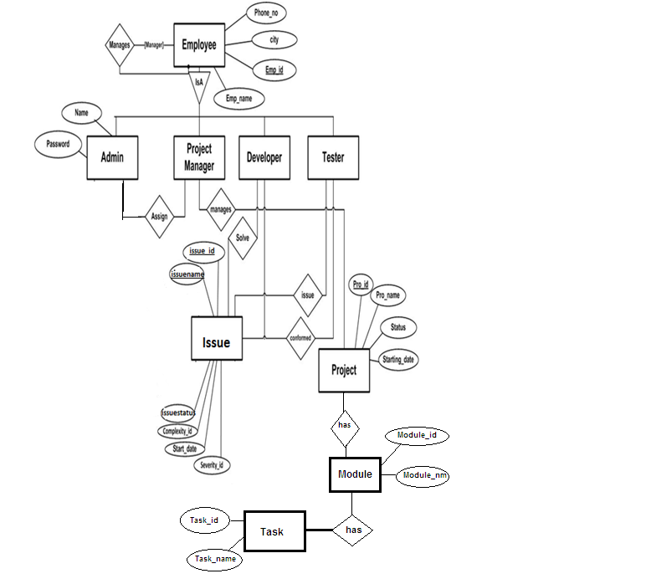

Slide 13
Data Flow Diagram

Slide 14
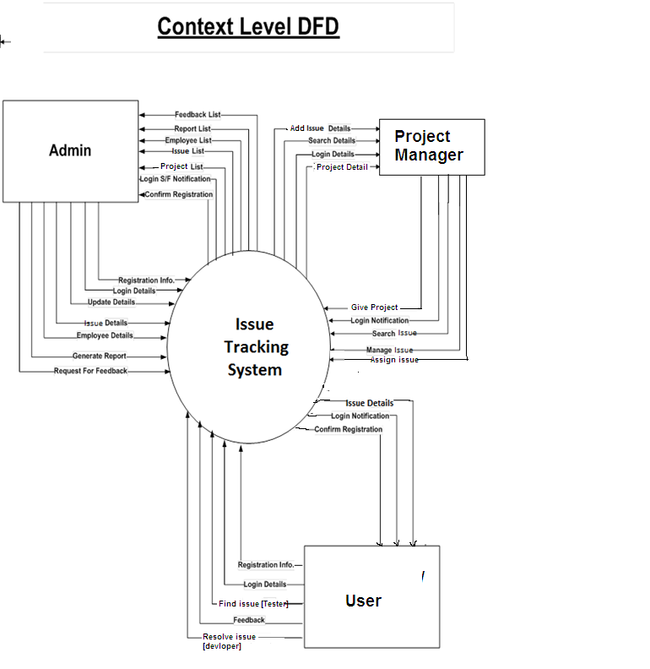

Slide 15
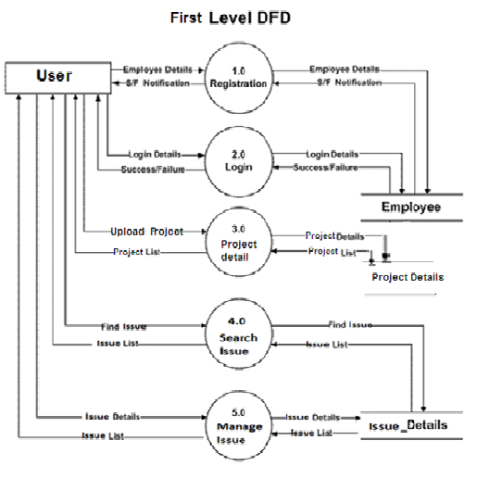

Slide 16
Second Level DFD for Project Manager:

Slide 17
Third Level DFD for Project Manager:

Slide 18
Data Dictionary

Slide 19
1. Tbl_country
Description: Contain the Country
Field Name | Description | Type | Size | Constraint | Default Value
country_id | Country ID | Number | 3 | PK | Not Null
country_name | Country Name | Varchar2 | 50 |  | Not Null

Slide 20
2. Tbl_STATE
Description: Contain the State
Field Name | Description | Type | Size | Constraint | Default Value
state_id | State ID | Number | 3 | PK | Not Null
state_name | State Name | Varchar2 | 50 |  | Not Null
country_id | Country ID | Number | 3 | FK | Not Null

Slide 21
3. Tbl_city
Description: Enter the city
Field Name | Description | Type | Size | Constraint | Default Value
city_id | City ID | Number | 3 | PK | Not Null
city_name | City Name | Varchar2 | 50 |  | Not Null
state_id | State ID | Number | 3 | FK | Not Null

Slide 22
4. Tbl_User_Role
Description: Contain the User Role
Field Name | Description | Type | Size | Constraint | Default Value
user_role_id | User Role ID | Number | 3 | PK | Not Null
user_role_description | User Role Description | Varchar2 | 50 |  | Not Null

Slide 23
5. Tbl_sequrity_question
Description: Enter the question for Sequrity.
Field Name | Description | Type | Size | Constraint | Default Value
security_question_id | Question ID | Number | 3 | PK | Not Null
security_question | Question | Varchar2 | 50 |  | Not Null

Slide 24
6. tbl_PMT_Priority
Description: contain all Project, Module & Task Priority (High,Low,Medium)
Field Name | Description | Type | Size | Contraint | Default Value
pmt_priority_id | Pmt Priority ID | Number | 5 | PK | Not Null
pmt_priority | Pmt Priority | Varchar2 | 50 |  | Not Null

Slide 25
7. tbl_PMT_Status
Description: Contain Project , Module, Task Status(for Exa : Hold, Running, Rejected)
Field Name | Description | Type | Size | Contraint | Default Value
pmt_status_id | Pmt Status ID | Number | 5 | PK | Not Null
pmt_status | Pmt Status | Varchar2 | 50 |  | Not Null

Slide 26
8. tbl_Project_Technology
Description: Contain all Project Language
Field Name | Description | Type | Size | Contraint | Default Value
project_Technology_id | Project Technology ID | Number | 5 | PK | Not Null
project_Technology | Project Technology | Varchar2 | 50 |  | Not Null

Slide 27
9. tbl_issue_type
Description: contain all issue Type. For Exa: Number Format Exception e. t. c.
Field Name | Description | Type | Size | Contraint | Default Value
Issue_type_id | Issue Type ID | Number | 5 | Primary key | Not Null
Issue_type | Issue Type | Varchar2 | 50 |  | Not Null

Slide 28
10.tbl_Issue_Priority
Description: contain issue Priority For Exa: High, Low, Medium
Field Name | Description | Type | Size | Contraint | Default Value
Issue_priority_id | Issue Priority ID | Number | 5 | PK | Not Null
Issue_priority | Issue Priority | Varchar2 | 50 |  | Not Null

Slide 29
11. tbl_Issue_Status
Description: contain all issue status name and its details
Field Name | Description | Type | Size | Contraint | Default Value
Issue_status_id | Issue Status ID | Number | 5 | PK | Not Null
Issue_status | Issue Status | Varchar2 | 50 |  | Not Null

Slide 30
12.tbl_OS
Description: Contain All the Operating System
Field Name | Description | Type | Size | Contraint | Default Value
os_id | OS ID | Number | 5 | PK | Not Null
Os | OS | Varchar2 | 50 |  | Not Null

Slide 31
13.Tbl_user_type
Description: Type of User
Field Name | Description | Type | Size | Contraint | Default Value
User_type_id | Uniquely Identify ID | Number | 2 | PK | Not Null
User_type | User Type | Varchar2 | 30 | - | Not Null

Slide 32
13.tbl_Feedback
Description: contain all user feedback
Field Name | Description | Type | Size | Contraint | Default Value
feedback_id | Feedback ID | Number | 5 | PK | Not Null
feedback_name | Feedback name | Varchar22 | 50 |  | Not Null
feedback_Description | Feedback Description | Varchar22 | 100 |  | Not Null
feedback_date | feedback date | date |  |  | Not Null

Slide 33
14. Tbl_projectmaster
Description:Contain the Project Name and its Detail
Field Name | Description | Type | Size | Contraint | Default Value
project_id | Project ID | Number | 5 | PK | Not Null
project_name | Project Name | Varchar2 | 50 |  | Not Null
project_description | Project Descritpion | Varchar2 | 200 |  | Not Null
project_estimate_start_date | Project Estimate Start Date | Date |  |  | Not Null
project_actual_start_date | Project Actual Start Date | Date |  |  | Null
project_estimate_end_date | Project Estimate End Date | Date |  |  | Not Null
project_actual_end_date | Project Actual End Date | Date |  |  | Null
pmt_priority_id | Project Priority ID | Number | 5 | FK | Not Null
pmt_status_id | Project Status ID | Number | 5 | FK | Not Null
project_category_id | Project Category ID | Number | 5 | FK | Not Null

Slide 34
15.tbl_module
Description: contain all modules name and its details
Field Name | Description | Type | Size | Contraint | Default Value
module_id | Module ID | Number | 5 | PK | Not Null
module_name | Module Name | Varchar2 | 50 |  | Not Null
module_description | Module Descritpion | Varchar2 | 200 |  | Not Null
module_estimate_start_date | Module Estimate Start Date | Date |  |  | Not Null
module_actual_start_date | Module Actual Start Date | Date |  |  | Null
module_estimate_end_date | Module Estimate End Date | Date |  |  | Not Null
module_actual_end_date | Module Actual End Date | Date |  |  | Null
pmt_priority_id | Module Priority ID | Number | 5 | FK | Not Null
pmt_status_id | Module Status ID | Number | 5 | FK | Not Null
proj_id | Project ID | Number | 5 | FK | Not Null

Slide 35
16.tbl_task
Description: contain all module’s task name and its details
Field Name | Description | Type | Size | Contraint | Default Value
task_id | Task ID | Number | 5 | PK | Not Null
task_name | Task Name | Varchar2 | 50 |  | Not Null
task_description | Task Descritpion | Varchar2 | 200 |  | Not Null
task_estimate_start_date | Task Estimate Start Date | Date |  |  | Not Null
task_actual_start_date | Task Actual Start Date | Date |  |  | Null
task_estimate_end_date | Task Estimate End Date | Date |  |  | Not Null
task_actual_end_date | Task Actual End Date | Date |  |  | Null
pmt_priority_id | Task Priority ID | Number | 5 | FK | Not Null
pmt_status_id | Task Status ID | Number | 5 | FK | Not Null
module_id | Module ID | Number | 5 | FK | Not Null

Slide 36
17.tbl_userregistration
Description:Contain all the User Detail.
Field Name | Description | Type | Size | Constraint | Default Value
user_id | User ID | Number | 5 | PK | Not Null
user_firstname | User First Name | Varchar2 | 30 |  | Not Null
user_middlename | User Middle Name | Varchar2 | 30 |  | Null
user_lastname | User Last Name | Varchar2 | 30 |  | Not Null
user_res_address | User Residential Address | Varchar2 | 250 |  | Not Null
user_per_address | User Permanent Address | Varchar2 | 250 |  | Not Null
city_id | City ID | Number | 3 | FK | Not Null
user_gender | User Gender | Varchar2 | 7 |  | Not Null
user_dob | User Date of Birth | Date | - |  | Not Null
user_phoneno | User Phone No | Number | 15 |  | Null
user_mobileno | User Mobile No | Number | 10 |  | Not Null
user_email | User Email ID | Varchar2 | 50 | Unique | Not Null
user_password | User Password | Varchar2 | 50 |  | Not Null
user_role_id | User Role ID | Number | 3 | FK | Not Null
security_question_id | Question ID | Number | 3 | FK | Not Null
user_question_ans | Security Question Ans | Varchar2 | 150 |  | Not Null
user_login_date | User Last Login Date | Date | - |  | Not Null
user_status | User Status | Number | 1 |  | Not Null

Slide 37
18. tbl_issue_detail
Description: contain all issuie detail
Field Name | Description | Type | Size | Contraint | Default Value
Issue_id | Issue ID | Number | 5 | PK | Not Null
Issue_title | Issue Title | Varchar2 | 50 |  | Not Null
Issue_desciption | Issue Description | Varchar2 | 500 |  | Not Null
Issue_type_id | Issue Type ID | Number | 5 | FK | Not Null
Issue_creation_date | Issue Creation Date | Date |  |  | Not Null
Issue_task_id | Issue Task ID | Number | 5 | FK | Not Null
user_id | Issue Post User ID | Number | 5 | FK | Not Null
os_id | OS | Number | 5 | FK | Not Null
Issue_priority_id | Issue Priority ID | Number | 5 | FK | Not Null
Issue_status_id | Issue Status ID | Number | 5 | FK | Not Null
Issue_status_date | Issue Status Date | Date |  |  | Not Null

Slide 38
19. tbl_issue_assign
Description: Project manager assign a issue to developer and Tester
Field Name | Description | Type | Size | Contraint | Default Value
Issue_assign_id | Uniquely Identify ID | Number | 5 | PK | Not Null
Issue_id | Issue ID | Number | 5 | FK | Not Null
Issue_assign_to | Issue Assign To (User ID) | Number | 5 | FK | Not Null
Issue_reported_by | Issue Reported By (User ID) | Number | 5 | FK | Not Null
Issue_assign_date | Issue Reported Date | Date |  |  | Not Null

Slide 39
20. tbl_issue_resolution
Description: Detail of the solve issue
Field Name | Description | Type | Size | Contraint | Default Value
Issue_resolution_id | Uniquely Identify ID | Number | 5 | PK | Not Null
Issue_id | Issue ID | Number | 5 | FK | Not Null
Issue_action_type | Issue Action Type | Varchar2 | 100 |  | Not Null
Issue_action_description | Issue Action Description | Varchar2 | 500 |  | Not Null
Issue_resolved_by | Issue Resolved By(User ID) | Number | 5 | FK | Not Null
Issue_resolved_date | Issue Resolved Date | Date |  |  | Not Null

Slide 40
21. tbl_Project_User
Description: Find user work on which Project
Field Name | Description | Type | Size | Contraint | Default Value
project_user_id | Project User ID | Number | 5 | PK | Not Null
project_id | Project ID | Number | 5 | FK | Not Null
user_id | User_id | Number | 5 | FK | Not Null
role_id | Role_id | Number | 5 | FK | Not Null

Slide 41
Scope of System

Slide 42
Fesibility System
A feasibility study is undertaken to determine the possibility or probability of either improving the existing system or developing a completely new system.
There are three aspects in feasibility study portion of the preliminary investigation.
Technical feasibility.
Economic feasibility and
Operational feasibility of the project.

Slide 43
Technical Feasibility
Technical Feasibility determines whether the work for the project be done with the present equipment, current procedures, existing software’s technology and available personnel?
If new technology is needed then what alternatives will be needed in the present structure?
This will require a close examination of the present system.
The technical feasibility should ask questions related to:
1. Adequacy of available technology.
2. Adequacy of hardware.
3. Available of computer.
4. Operating time and support facilities, etc.

Slide 44
Economic feasibility
Economic feasibility looks at the financial aspects of the project. Economic feasibility concerns with the returns from the investments in a project. It determines whether it is worthwhile to invest the money in the proposed system. It is not worthwhile spending a lot of money on a project for no returns.
To carry out an economic feasibility for a system, it is necessary to place actual money value against any activities needed to implement the project.
The Issue Tracking System plans to acquire the necessary hardware and software require for the system and there is no hindrance whether economical or otherwise towards its purchase. A brief description of the hardware and software required in the system is given later in the report.

Slide 45
Operational Feasibility
Operational feasibility covers two aspects. One is the technical performance aspect and other is the acceptance within Issue Tracking System. Operational feasibility determines how the proposed system will fit in the current operations and what, if any job restructuring and retraining may be needed to implement the system.
In the system operational feasibility checks, whether the user who is going to use the system is able to work with the software’s with which the system is coded and also the mind of the user going to use the system. If the user does not understand or is able to work on the system further development is of waste.

Slide 46
Screen Shot

Slide 47
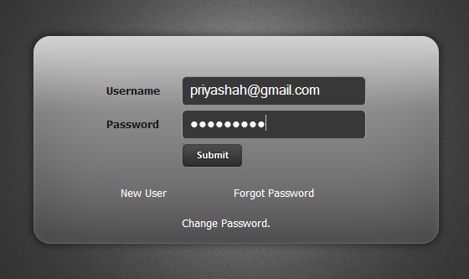
Login Form:-

Slide 48
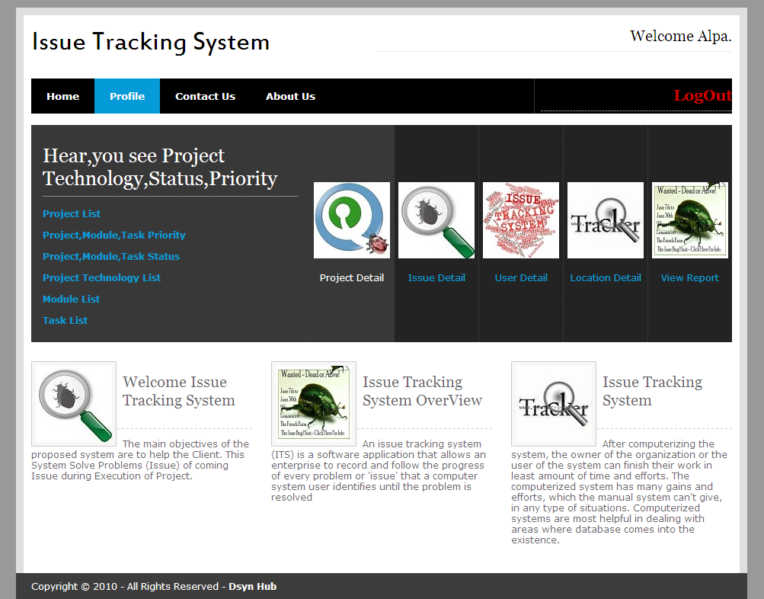
Admin Home Page:

Slide 49
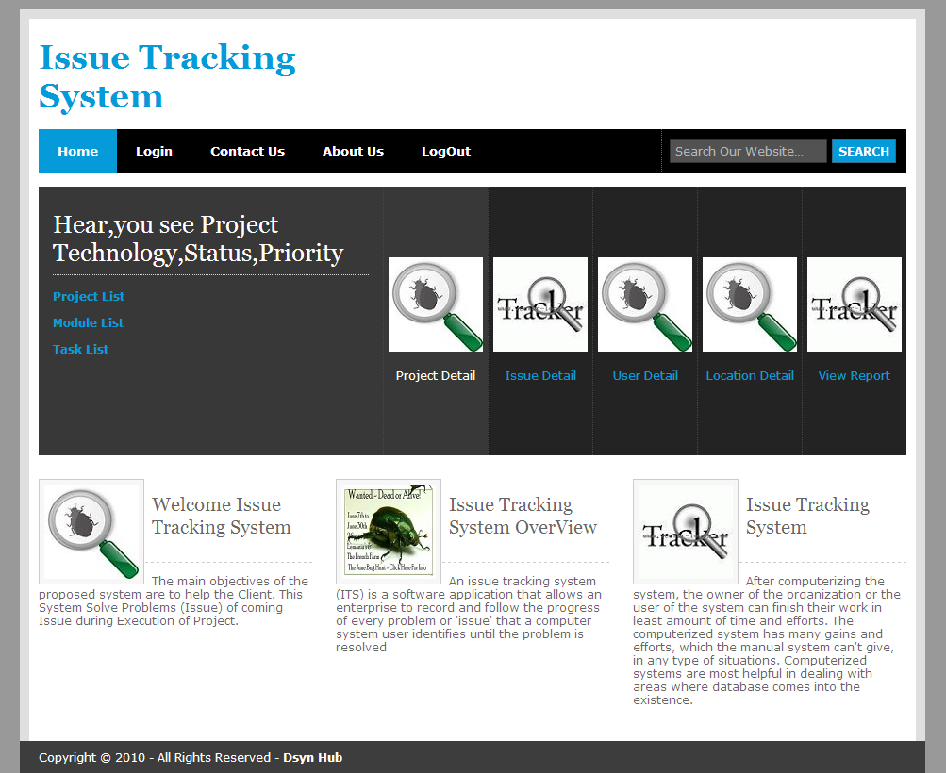
Project Manager Home Page:

Slide 50
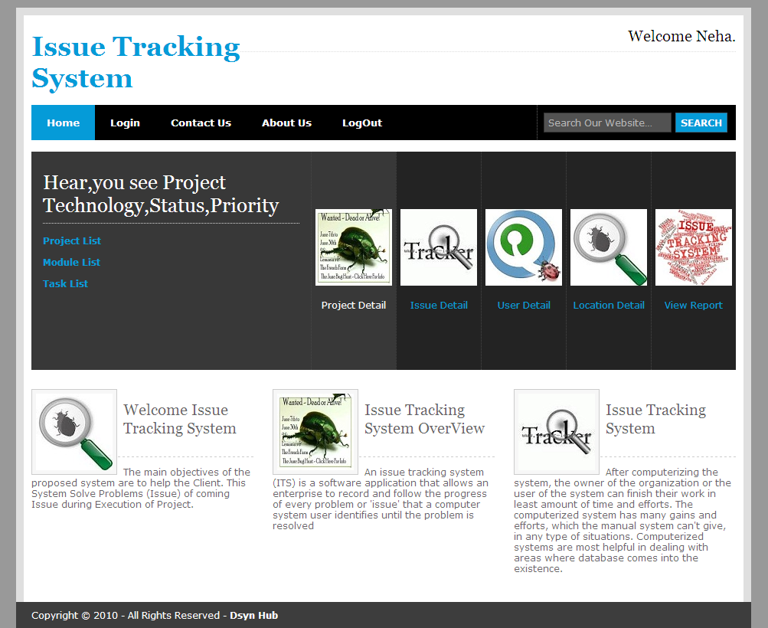
Developer Home Page

Slide 51
Tester Home Page:-

Slide 52
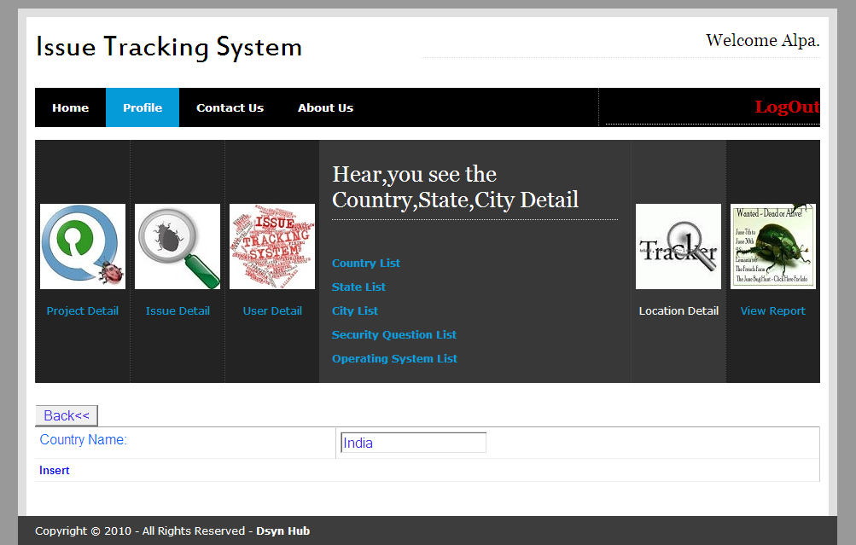
Country List Form:-

Slide 53
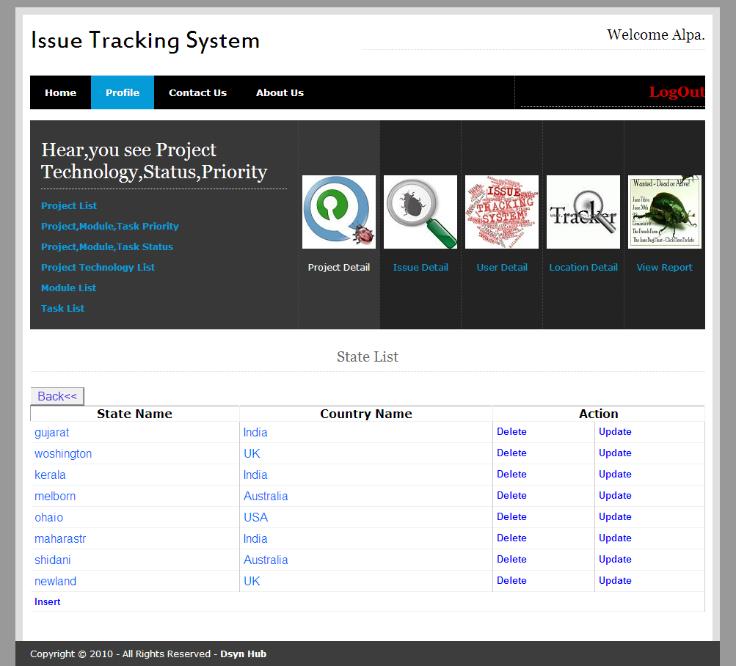
State List Form

Slide 54
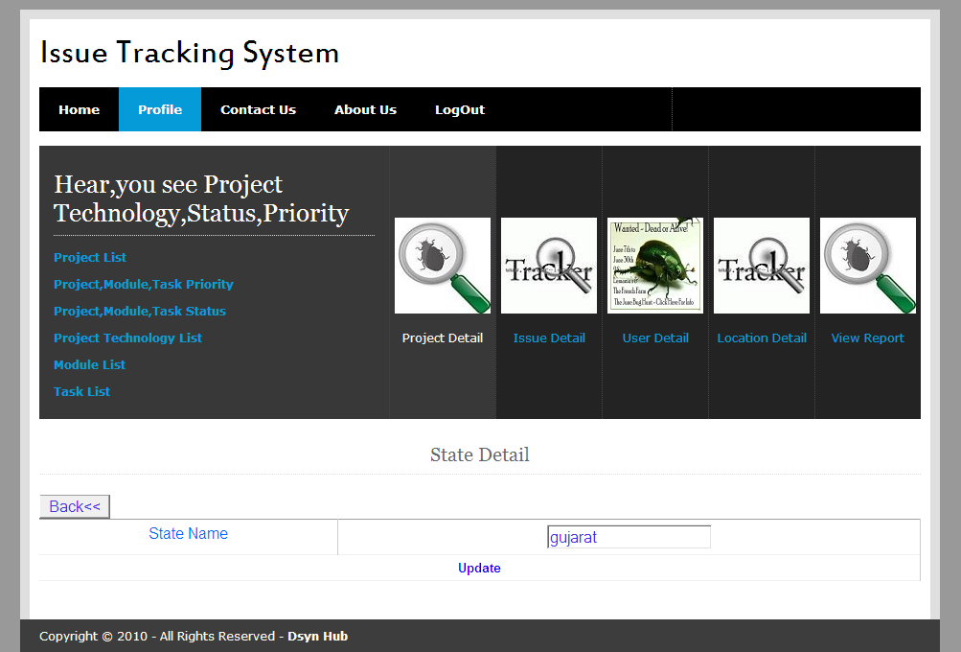
State Edit Form:-

Slide 55
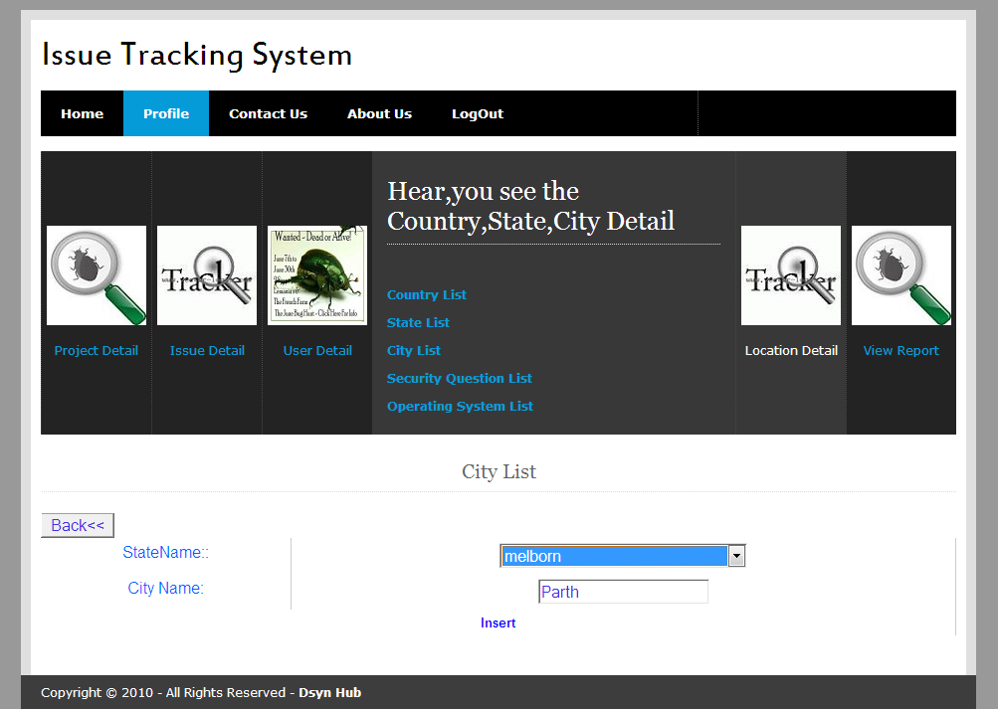
City Insert Form:-

Slide 56
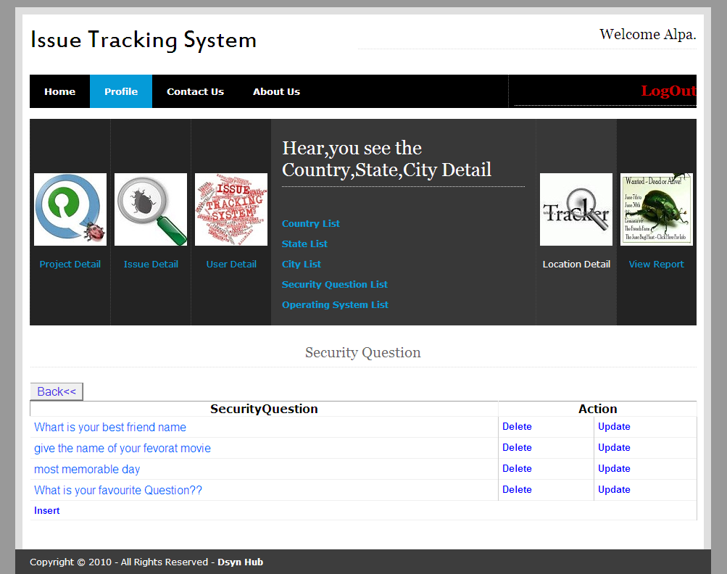
Security Question List Form:-

Slide 57
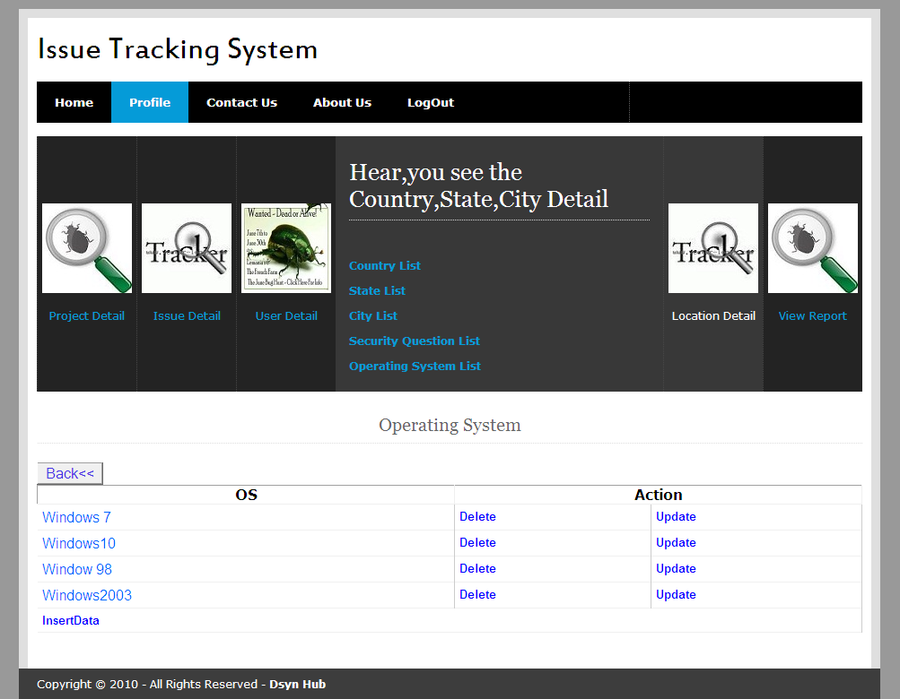
Operating System Insert:-

Slide 58
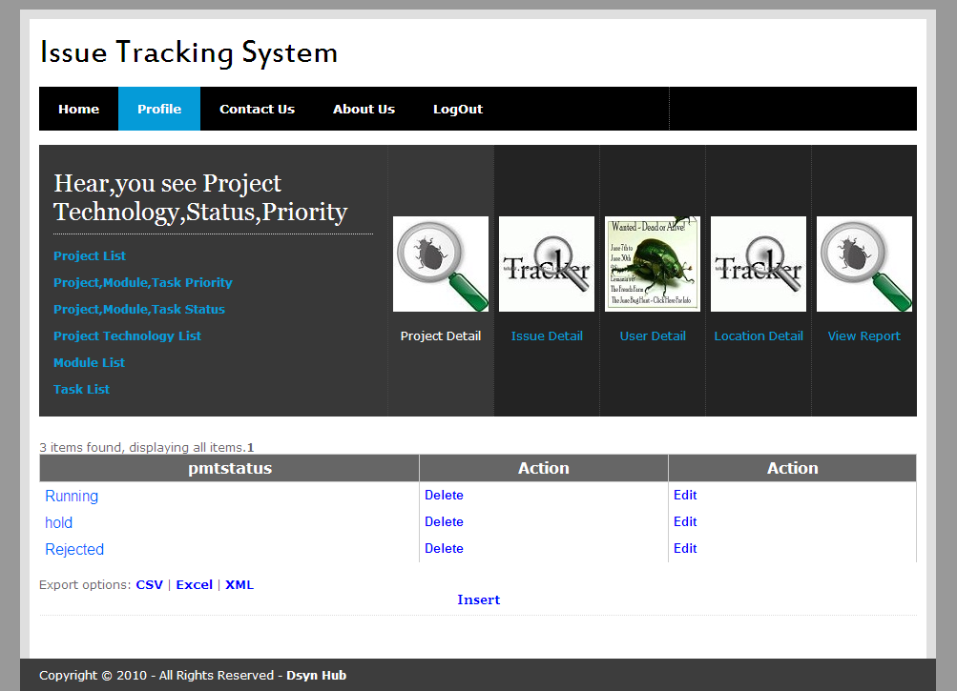
Project,Module,Task Status List:-

Slide 59
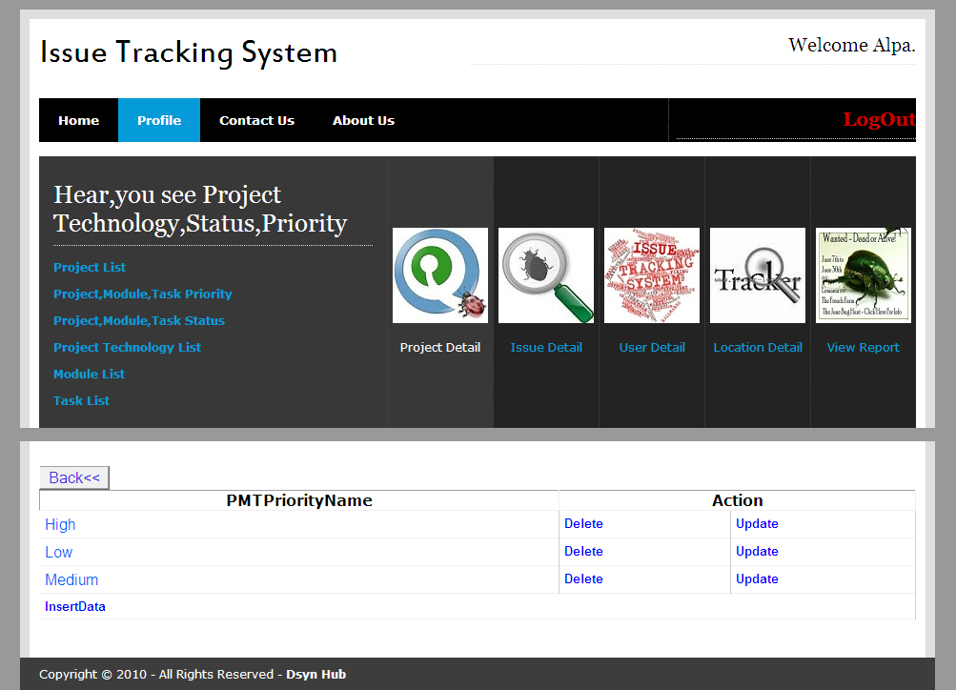
Project,Module,Task Priority List:-

Slide 60
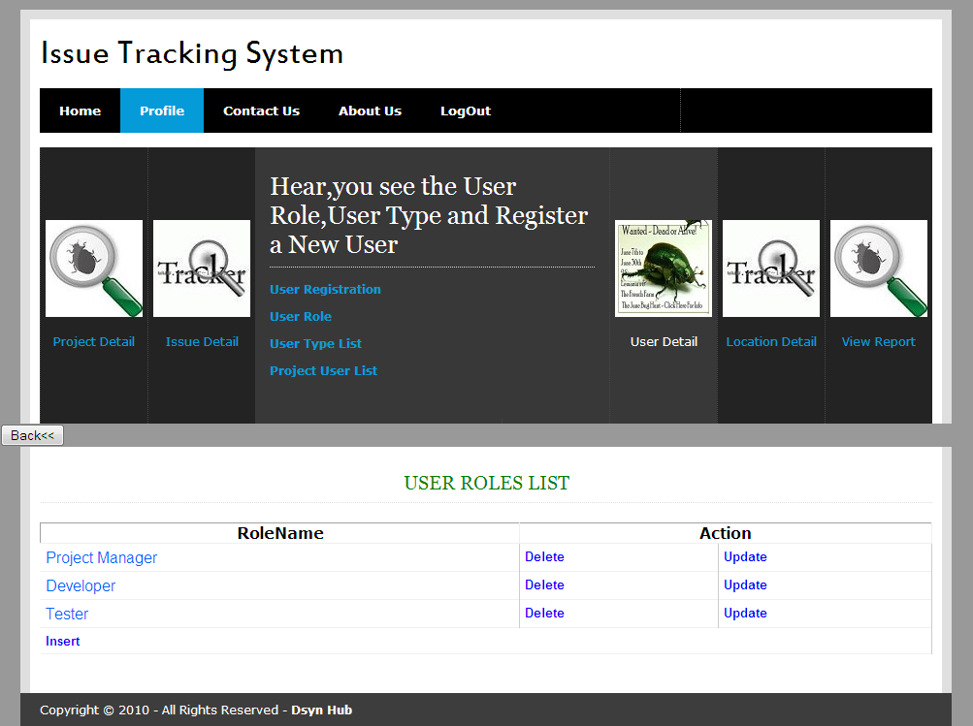
User Role:-

Slide 61
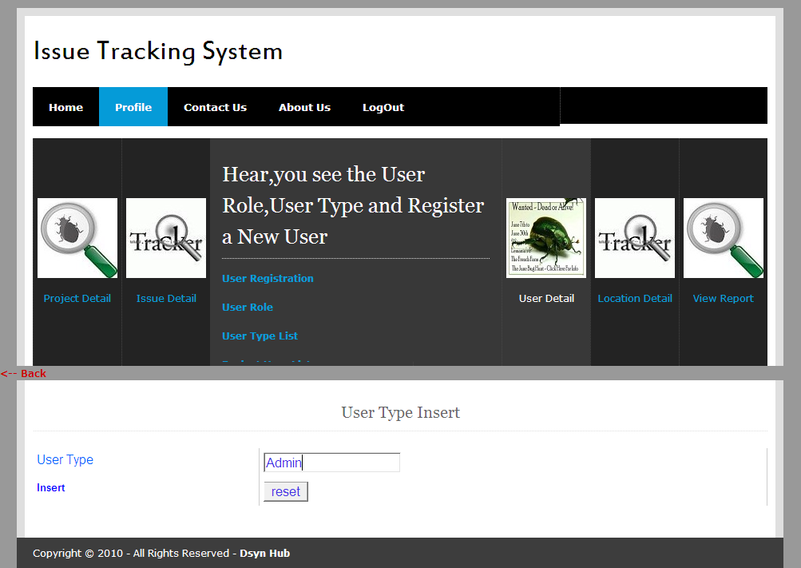
User Type Insert:-

Slide 62
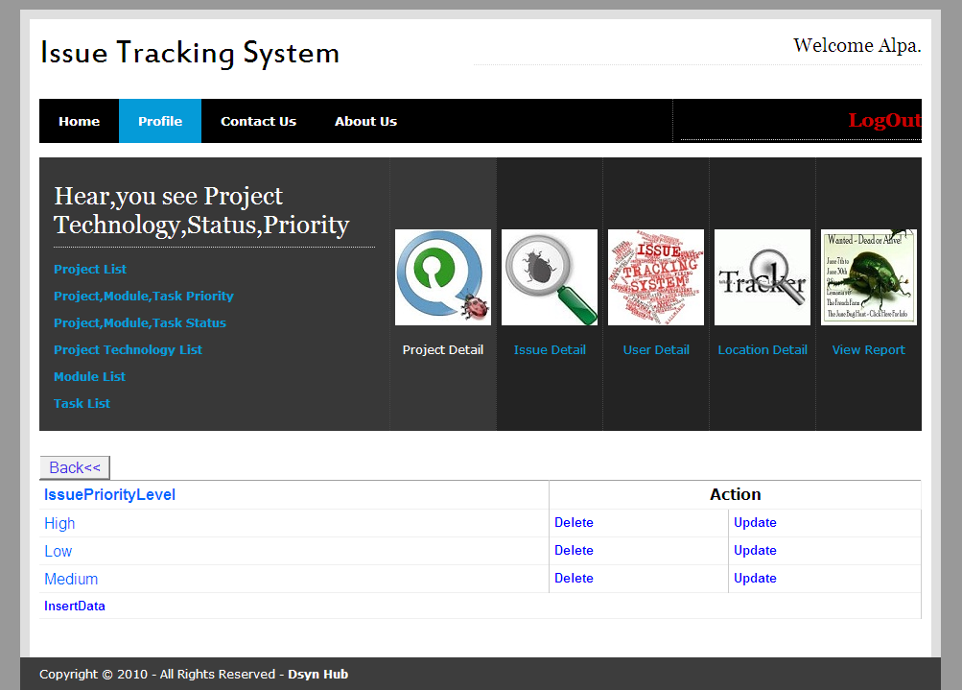
Issue Priority List:-

Slide 63
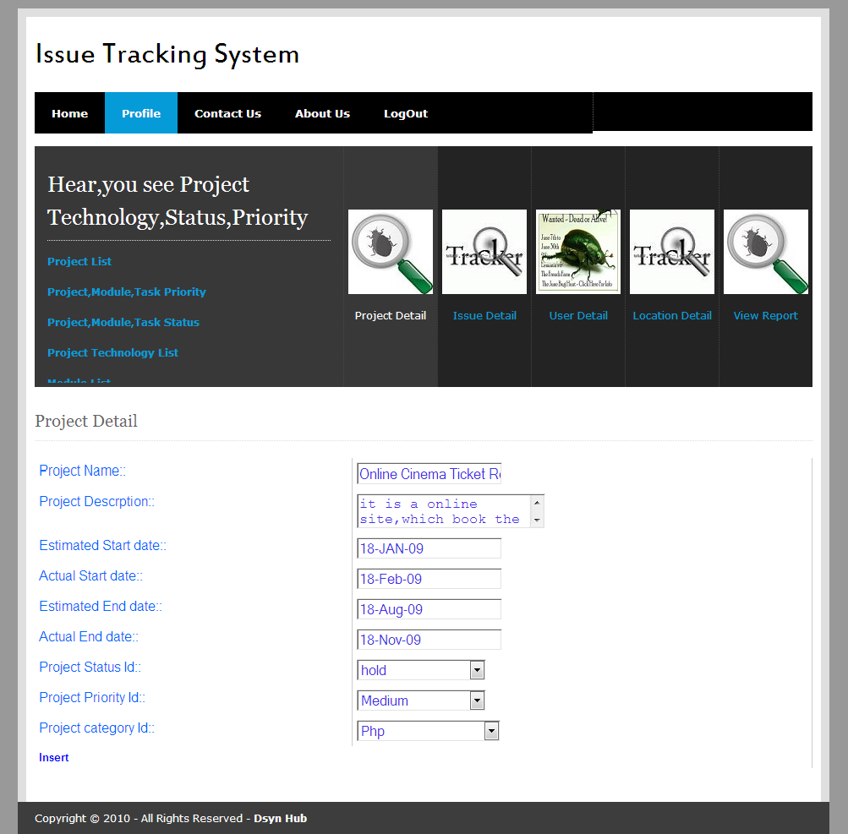
Project Master Insert:-

Slide 64
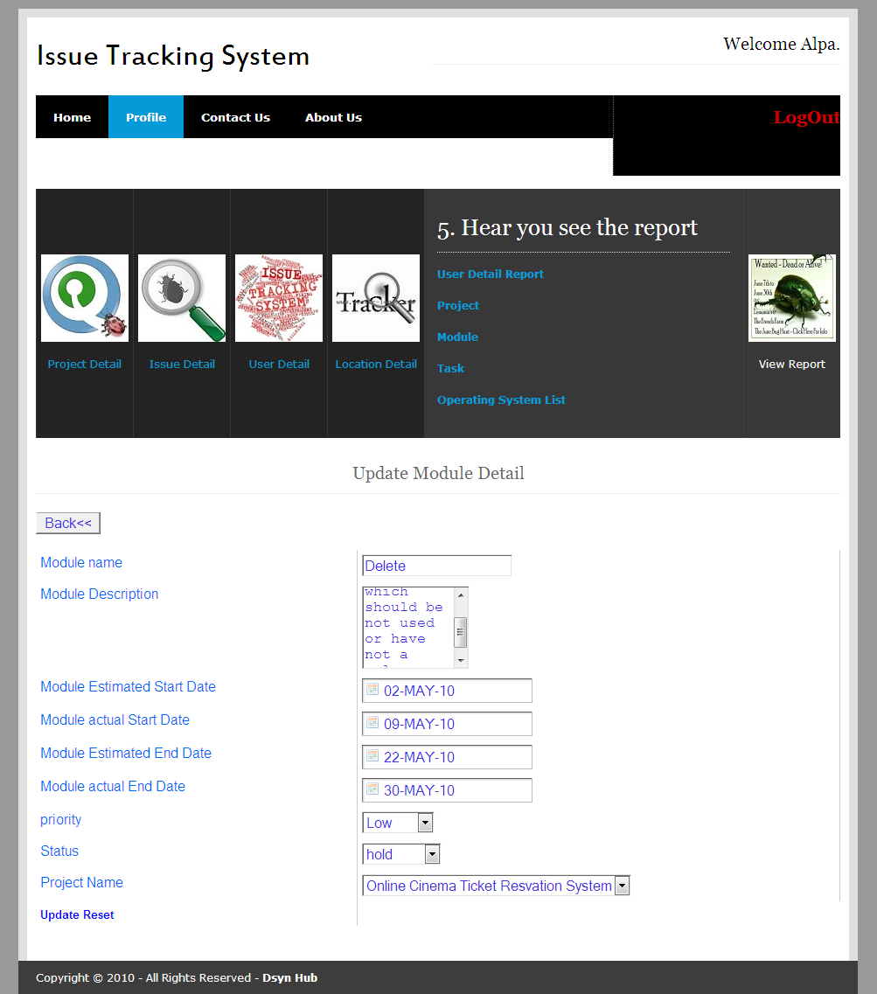
Module Detail Update

Slide 65
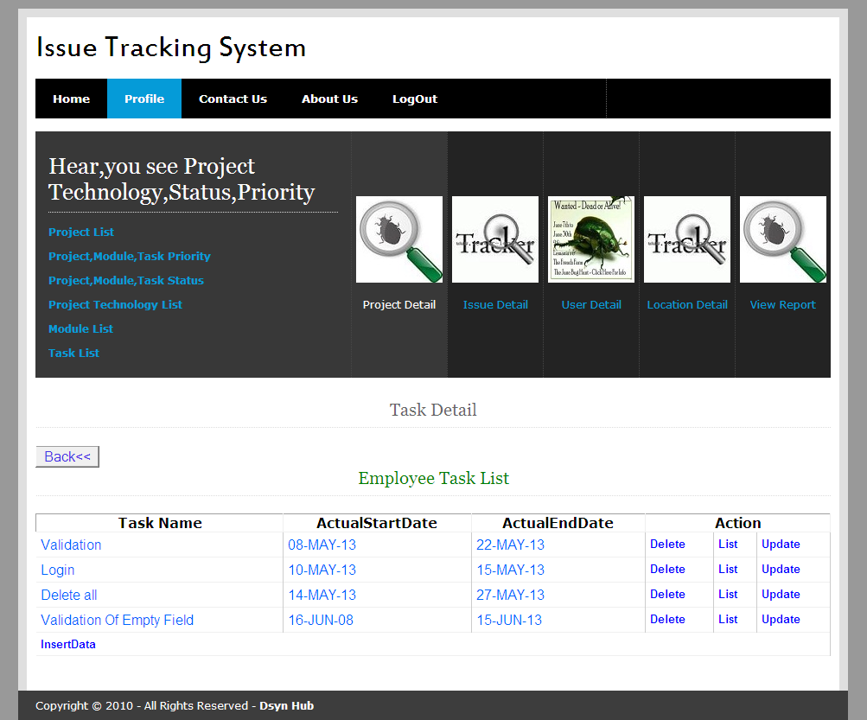
Task List

Slide 66
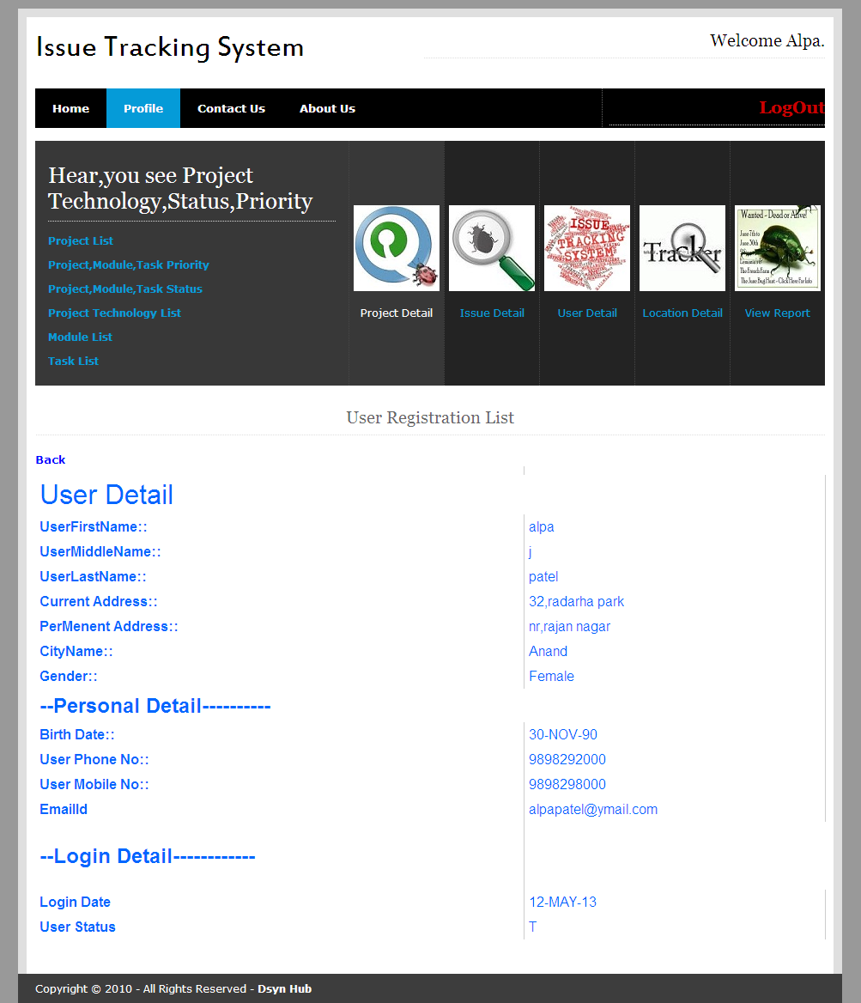
View User Profile

Slide 67
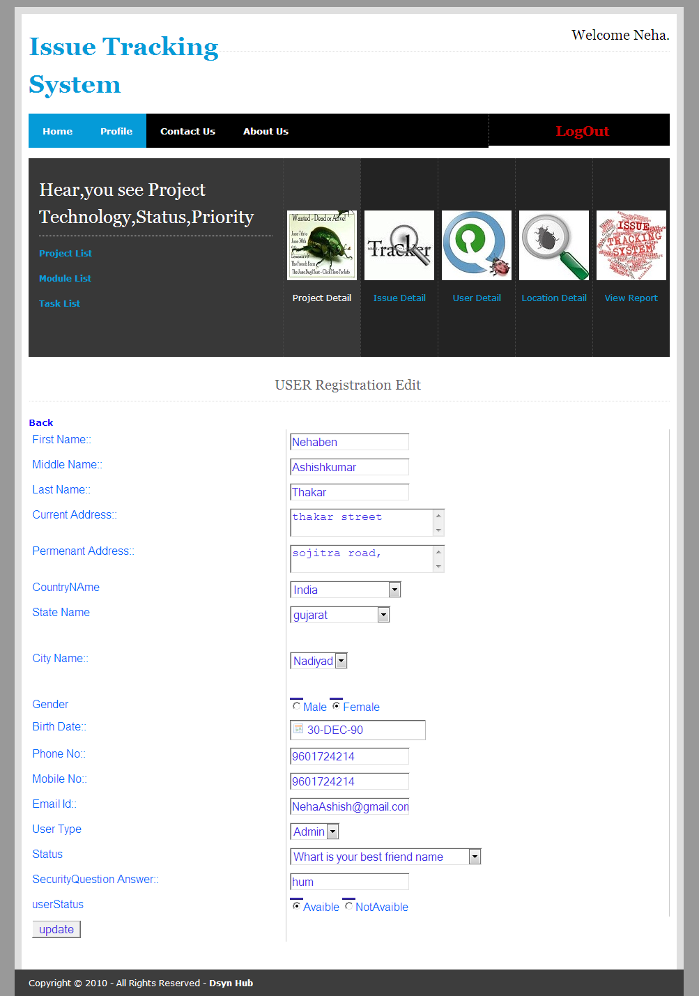
User Edit Profile

Slide 68
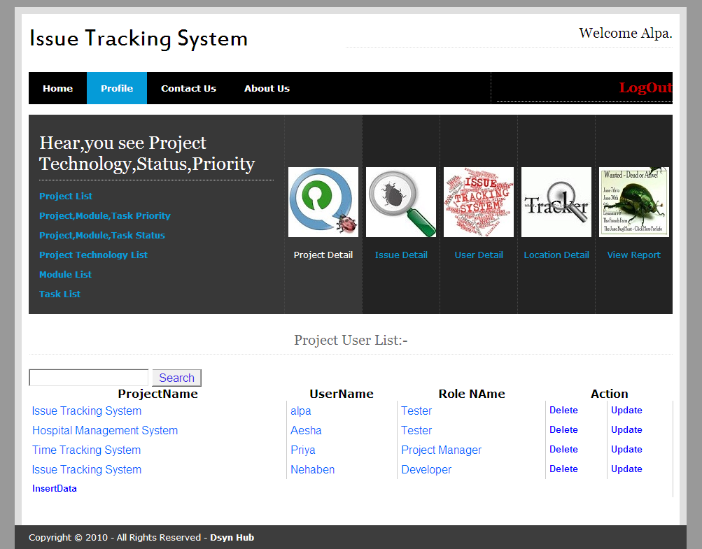
Project User List

Slide 69
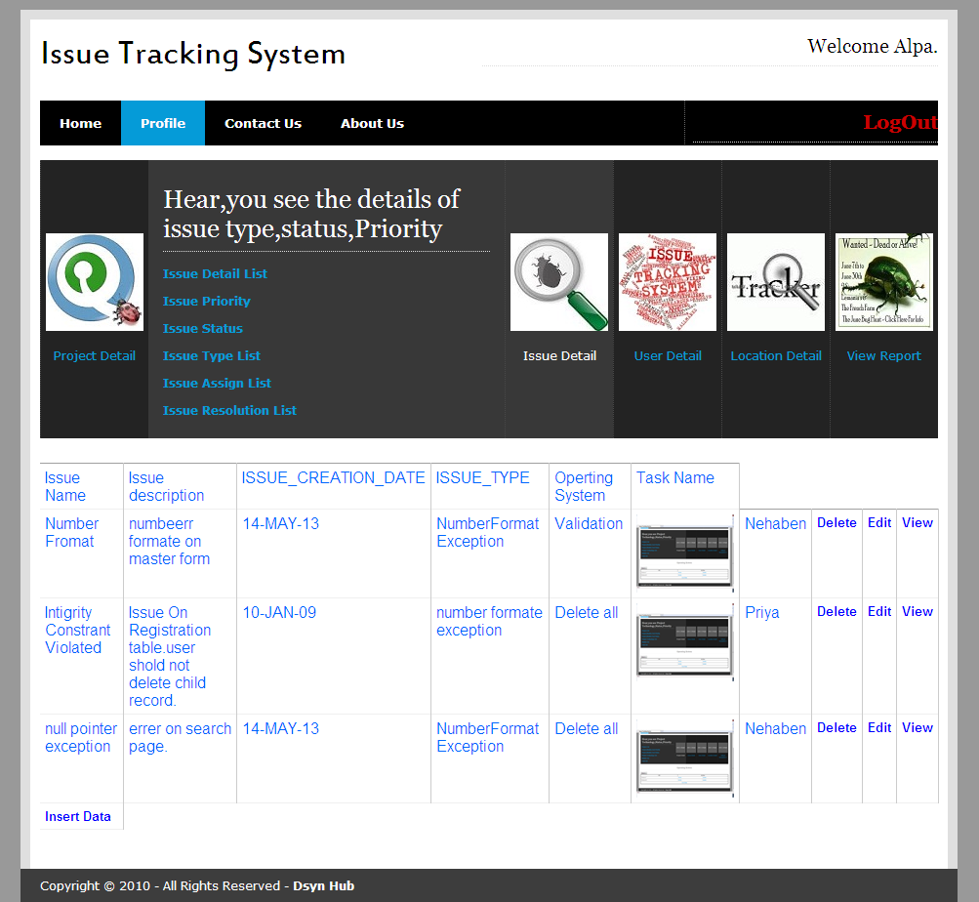
Issue Detail list

Slide 70
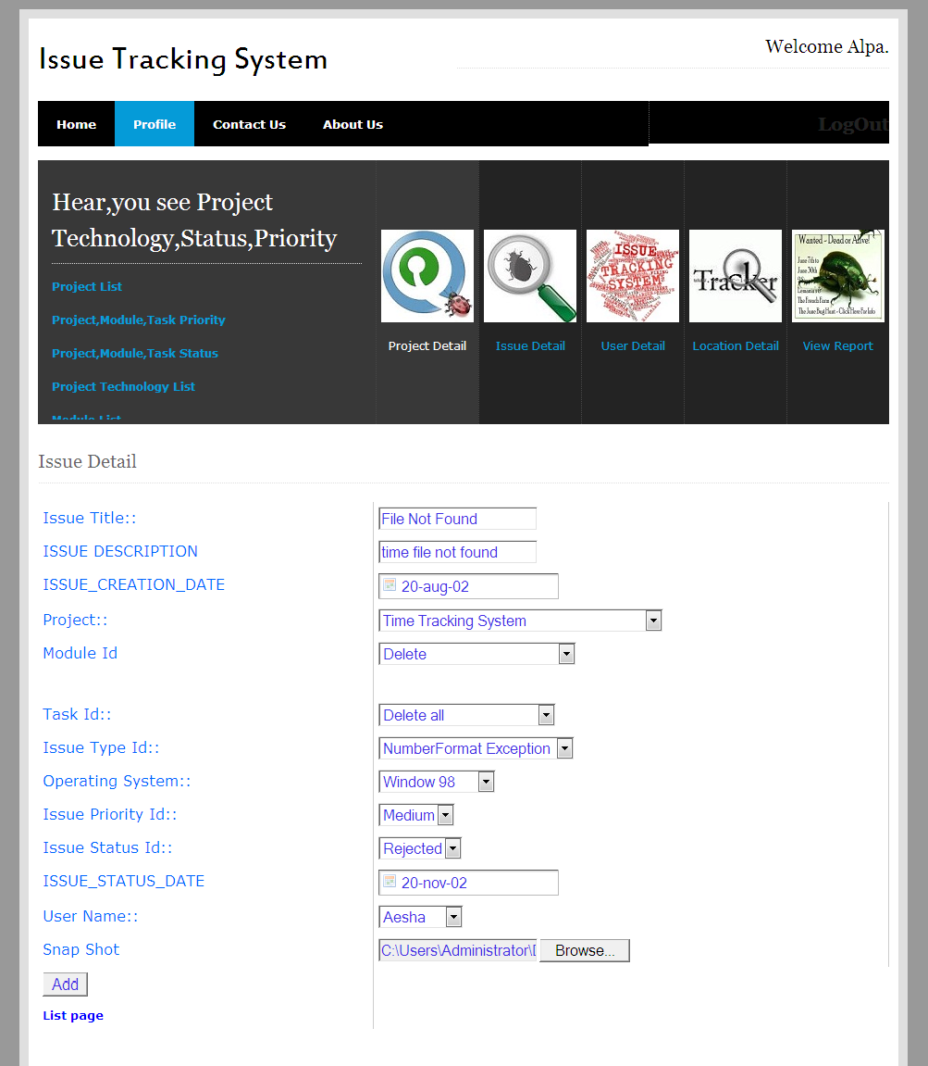
Issue Insert Form

Slide 71
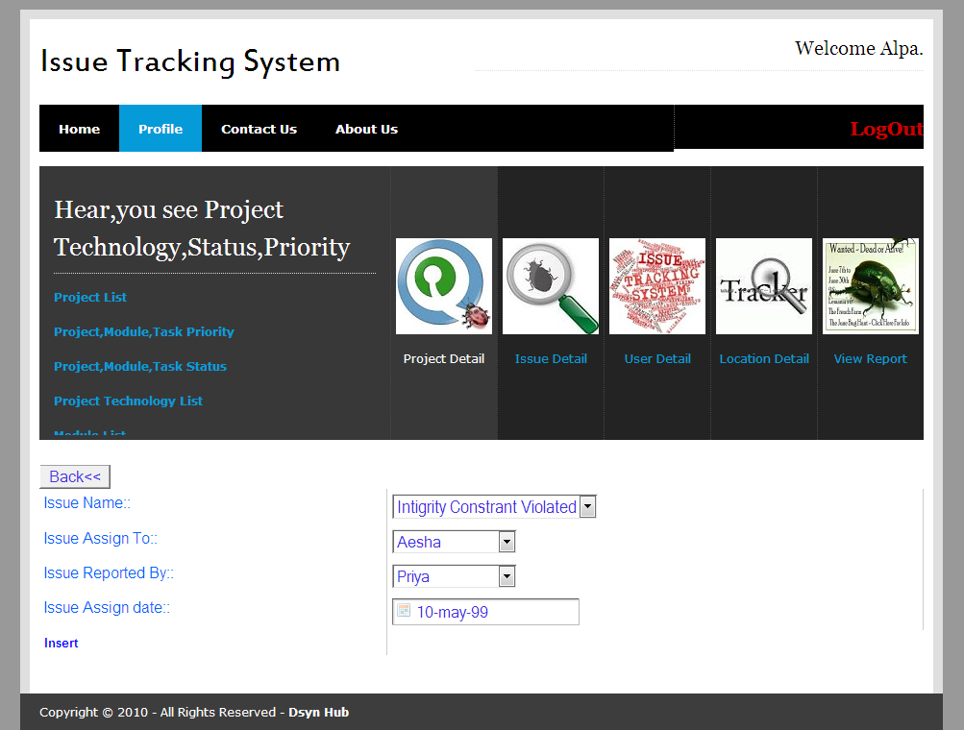
Issue Assign Insert:

Slide 72
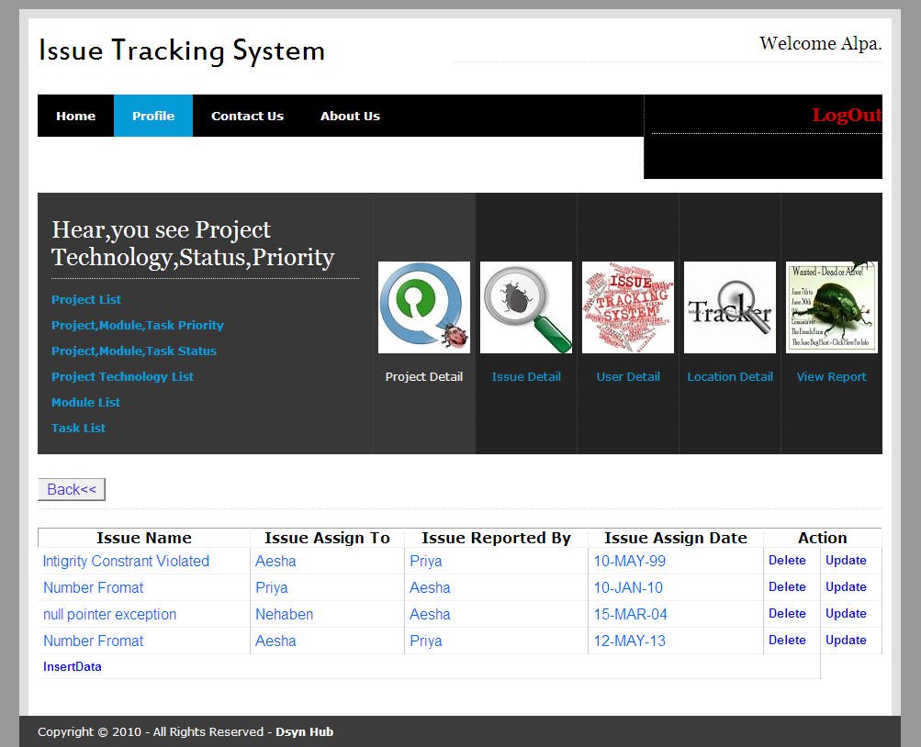
Issue Assign List

Slide 73
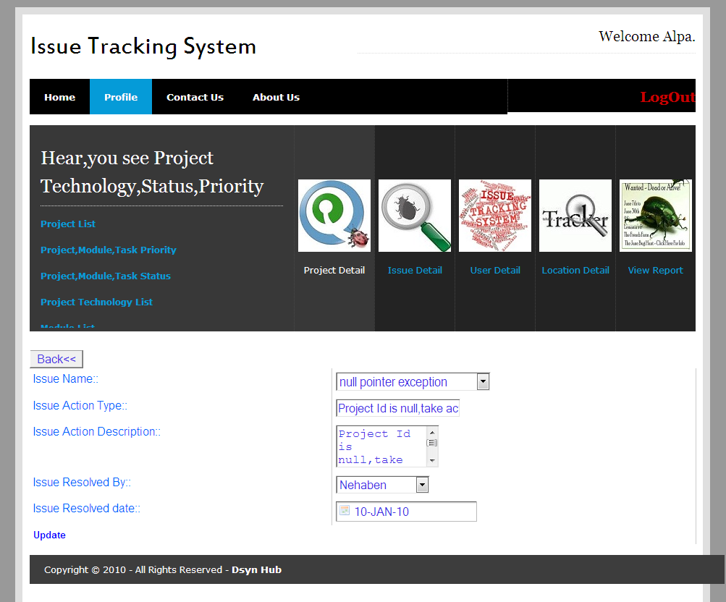
Issue Resolved Update:-

Slide 74
Functinality

Slide 75
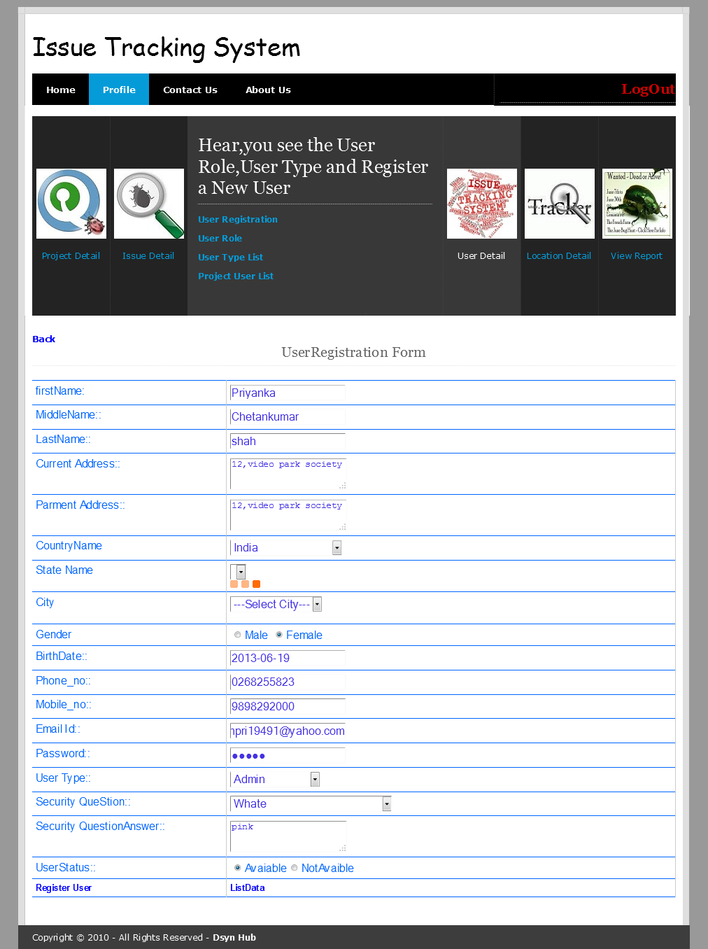
Directing Web Remoting(DWR)

Slide 76
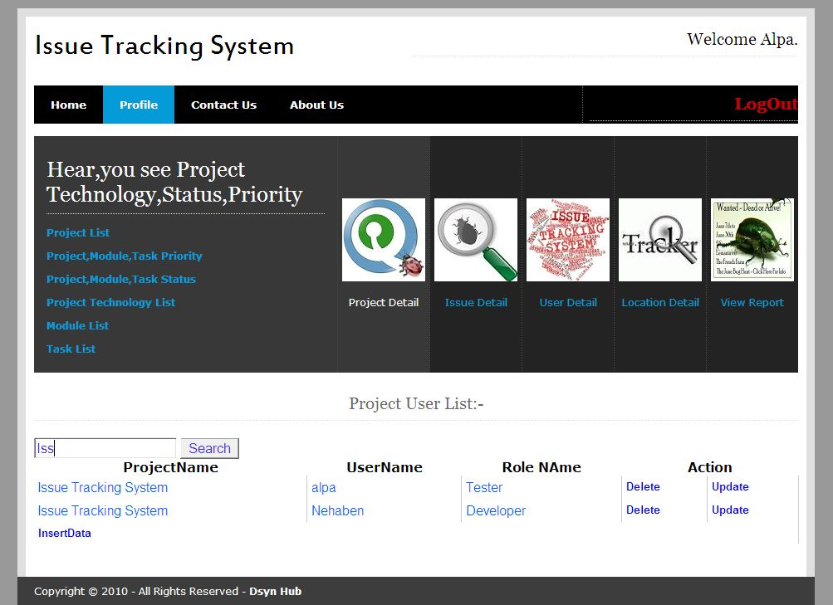
Search Form:

Slide 77
File Upload:-

Slide 78
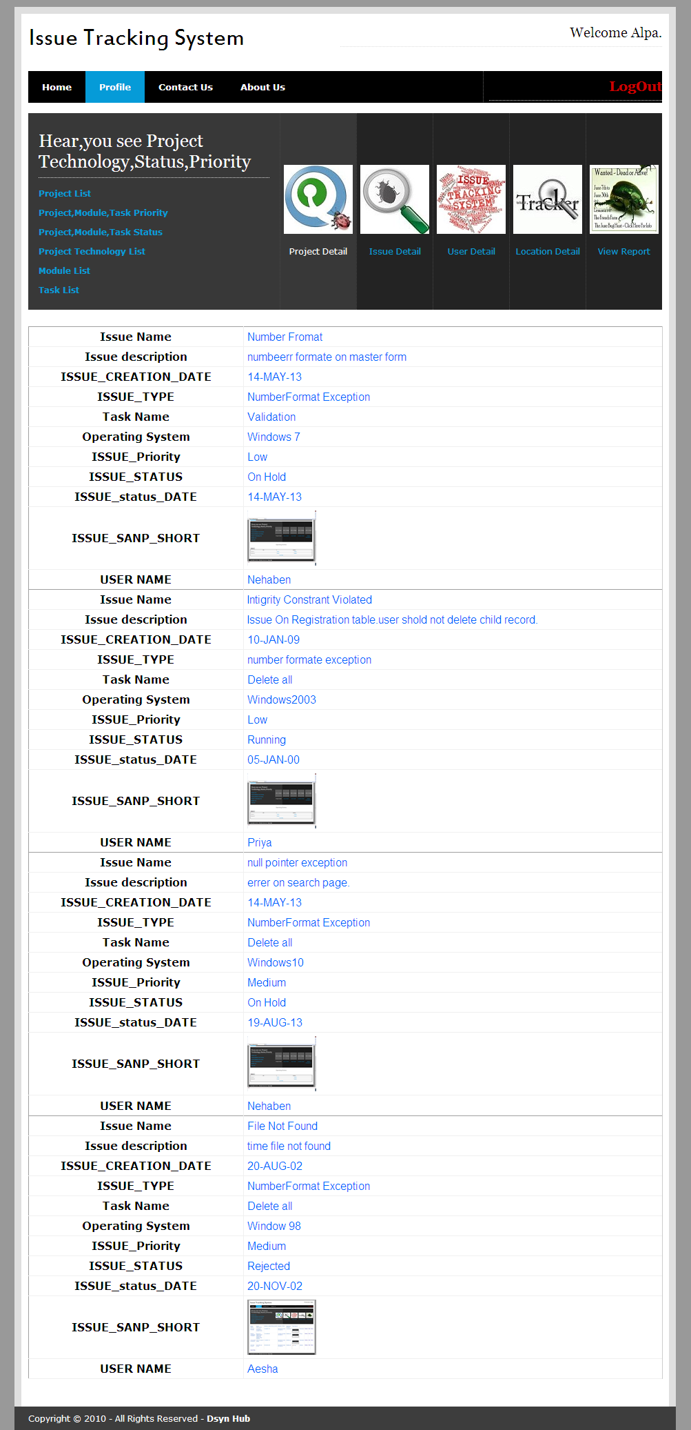
View Image

Slide 79
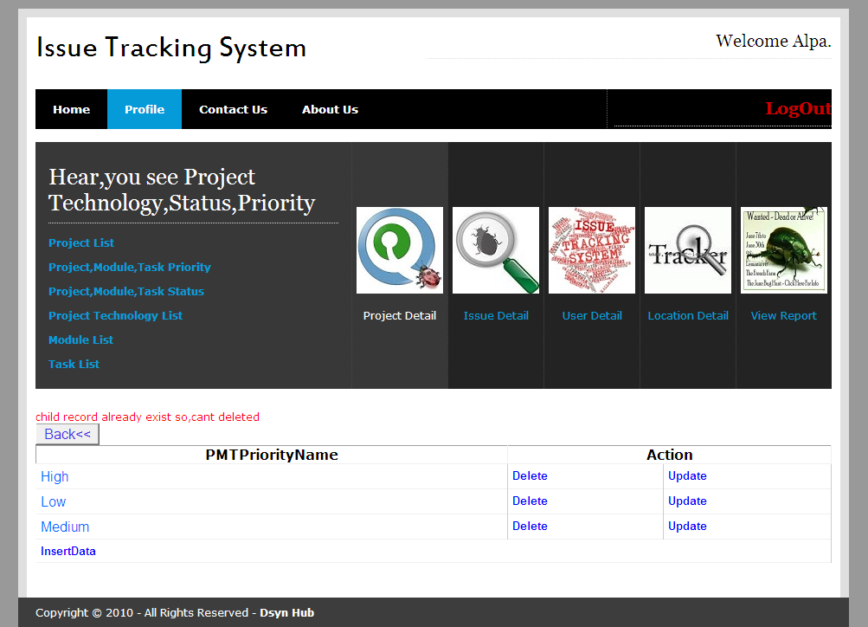
Delete(Child record not deleted):-

Slide 80
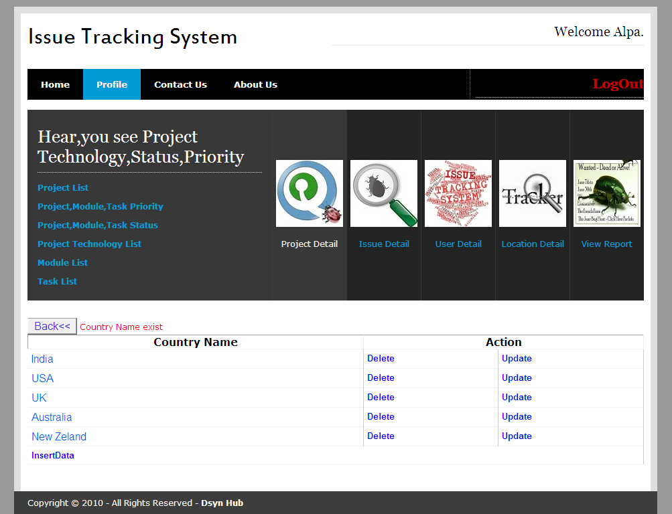
Insert(Duplicate Value Not Inserted):-

Slide 81
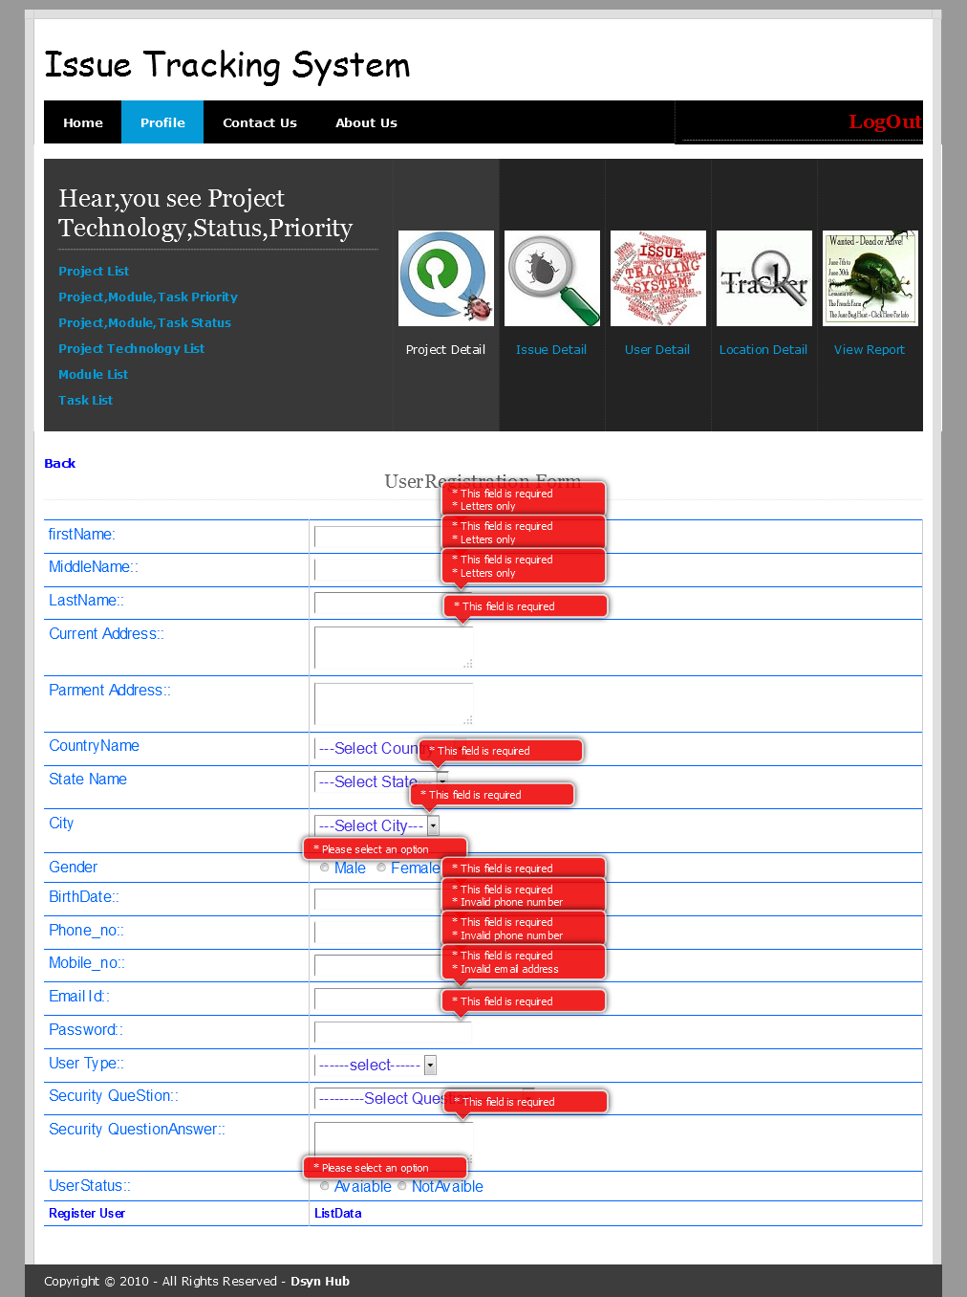
Client Side Validation:-

Slide 82
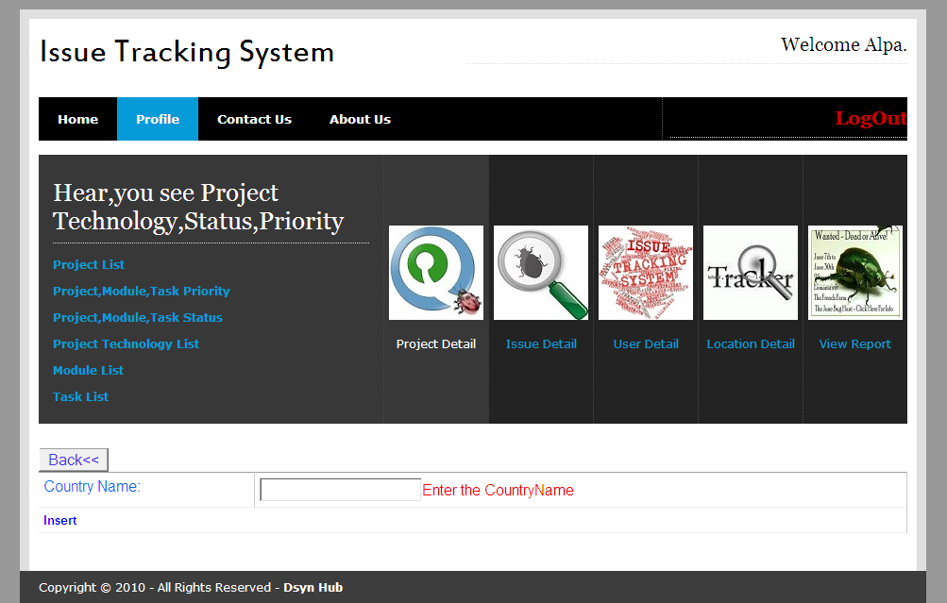
Server Side Validation

Slide 83

Maximum Size Validation

Slide 84
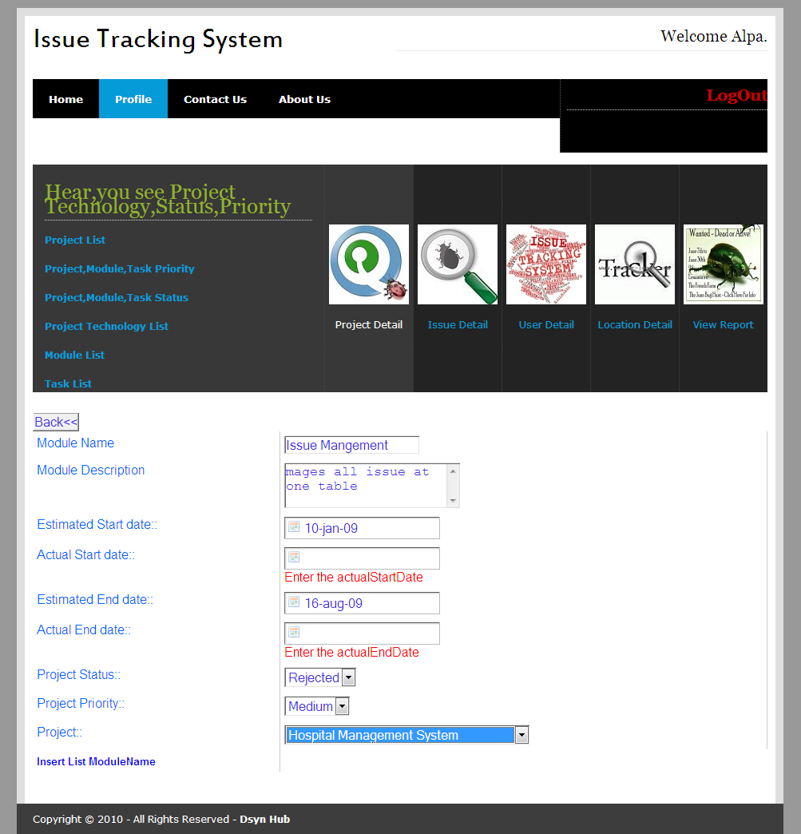
Date Validation:-

Slide 85
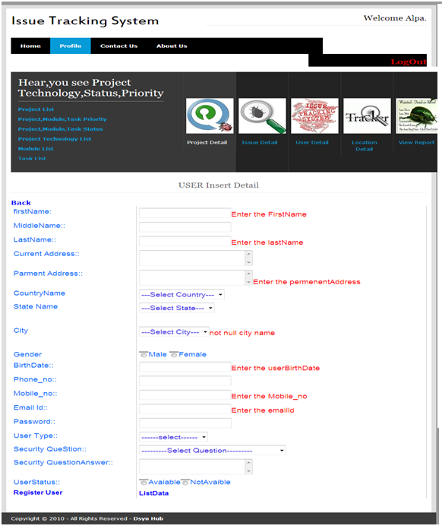
All Validation

Slide 86
Jasper Report

Slide 87
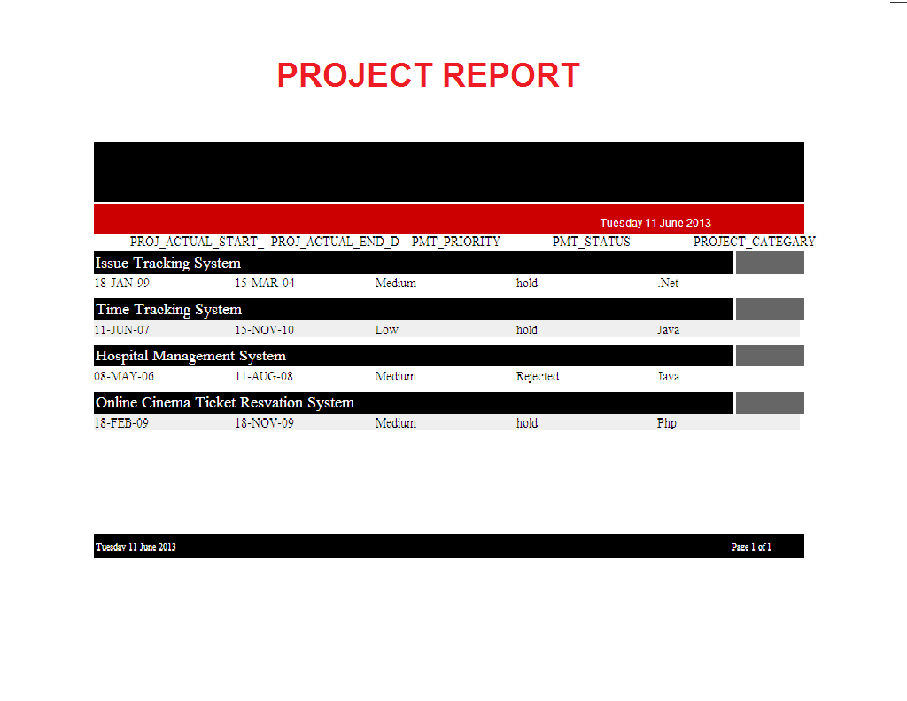
Project Report

Slide 88
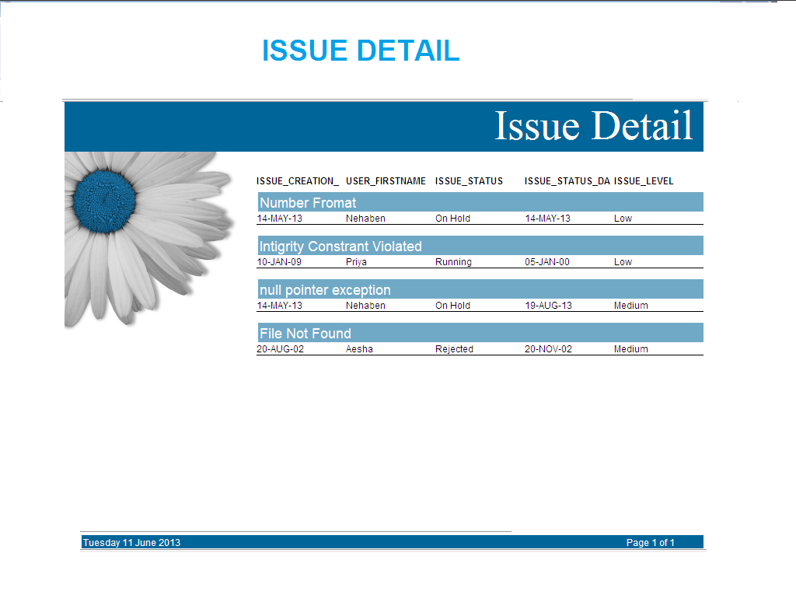
Issue detail:-

Slide 89
Future Work

Slide 90
Future Work
I want to improve our Application, as it is the more user friendly and simple, Main thing which attracts all users.
We Would To Make The Site More Eyes Catching As Compared To Current Page. We Can Use Flash So That The Site Becomes More Dynamic. Obviously Good on the Project More In Terms of Functionality. Since Functionality is The Key to Good Projects.
I will provide SMS feature for informing Client for Solved issue.
In future, we will work on mailing feature.
Through this feature, we can send mail to the Issue Tracker.
I would to make Scheduler which keeps Record of all Issue, such as when it finished, its last date of solve issue.
I would to make upload download module for uploading error page.

Slide 91
Conclusion
After having study of entire system we came to know that the given system is fulfilling the total requirements and also working very efficiently along with higher performance. Even the system has be developed in such a manner so that the user could be easily be familiar with the system with a small training session about application. The system has been developed using platform java which provides higher stability to the time tracking system.
There is a good scope to have better development in future in the same system without whole system replacement. Any system developed with such a good concept is always acceptable not only in the current scenario but also for the future development.

Slide 92


